Slide 1
Team Ink3D Status 3/28/14
Daniel Lain
Tim Edmonson
Shawn Simonson
Jesse Bowles

Slide 2
Project Status
Task Number | Task Name | Planned Start | Planned Finish | Planned Work Hours | Actual Work Hours | % Work Completed | Earned Vaule
2 | Senior Design 2 | Wed 1/15/14 | Fri 5/23/14 | 762 | 307 | 33.07 | 252
2.1 | Documents | Wed 1/15/14 | Fri 5/23/14 | 242 | 256 | 100 | 242
2.1.1 | Detailed Design Documnetation | Tue 1/21/14 | Fri 2/28/14 | 142 | 212 | 100 | 142
2.1.1.1 | Version 1.0 | Tue 1/21/14 | Thu 2/20/14 | 72 | 208 | 100 | 72
2.1.1.2 | Version 2.0 | Wed 2/12/14 | Fri 2/28/14 | 70 | 4 | 100 | 70
2.1.2 | Test Plan | Thu 2/20/14 | Tue 3/18/14 | 100 | 44 | 100 | 100
2.2 | Prototype Implementation | Tue 2/18/14 | Thu 5/15/14 | 500 | 46 | 0 | 0
2.2.1 | Version 0.0 | Tue 3/18/14 | Tue 4/1/14 | 100 | 46 | 0 | 0
2.2.2 | Version 0.5 | Tue 3/4/14 | Tue 3/18/14 | 100 | 0 | 0 | 0
2.2.3 | Version 1.0 | Tue 3/18/14 | Tue 4/1/14 | 100 | 0 | 0 | 0
2.2.4 | Version 2.0 | Tue 4/1/14 | Tue 4/15/14 | 100 | 0 | 0 | 0
2.2.5 | Final Product | Tue 4/15/14 | Tue 4/29/14 | 100 | 0 | 0 | 0
2.3 | Final Documetation | Tue 4/1/14 | Tue 4/29/14 | 10 | 0 | 0 | 0
2.4 | Architecture Design Version 2.1 | Tue 1/21/14 | Mon 2/24/14 | 10 | 5 | 100 | 10
3 | Presentations | Fri 9/13/13 | Fri 4/25/14 | 49 | 49 | 89.8 | 44
3.4 | Detailed Design Review | Thu 2/20/14 | Tue 2/25/14 | 7 | 18 | 100 | 7
3.6 | Team Stauts Report SD2 | Thu 1/23/14 | Fri 4/25/14 | 8 | 4 | 37.5 | 3
4 | Team Meetings | Tue 9/10/13 | Tue 12/9/14 | 496 | 209 | 83.87 | 416
4.2 | Team Meeting SD2 | Tue 1/14/14 | Thu 5/1/14 | 272 | 101 | 70.59 | 192
5 | Sponser Meetings | Mon 9/9/13 | Tue 9/9/14 | 30 | 20 | 0 | 0
6 | MS Project | Sun 9/29/13 | Thu 10/23/14 | 40 | 30 | 50 | 20
6.2 | SD 2 | Thu 1/23/14 | Thu 1/23/14 | 20 | 8 | 0 | 0

Slide 3
Database
Issues
Rethink DB and Mater Configuration
JaxB Issue
Successes
All modules implemented
95% Tested

Slide 4
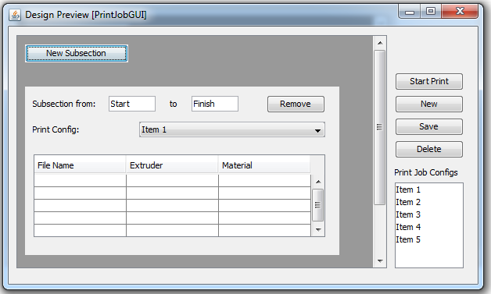
GUI Progress

Slide 5
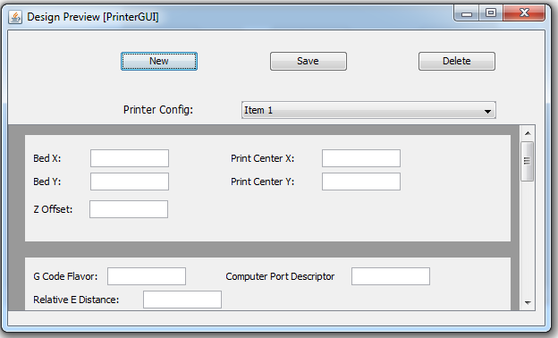
GUI Progress

Slide 6
Communications Layer Updates
Progress
Test program tested on virtual serial device
Live test session scheduled for next week
Communications layer (first iteration) on track for completion 4/1
Issues
Printer access
Multiple Windows drivers for printer hardware. (May be trial and error)
Looking Forward
Finalize communications layer based on live tests
Begin implementation of Printer Control Layer

Slide 7
Next Steps
Finish Stage One
DB
Processing Layers
Communications Layer
Start Stage Two
GUI / Controller part 1
Printer Control Layer

